Slide 1
Collections in Java
By Gitanjali More

Slide 2
Collections in Java The Collection in Java is a framework that provides an architecture to store and manipulate the group of objects. Java Collections can achieve all the operations that you perform on a data such as searching, sorting, insertion, manipulation, and deletion. Java Collection means a single unit of objects. Java Collection framework provides many interfaces (Set, List, Queue, Deque) and classes (ArrayList, Vector, LinkedList, PriorityQueue, HashSet, LinkedHashSet, TreeSet). A Collection represents a single unit of objects, i.e., a group

Slide 3
What is a framework in Java? A framework provides a ready-made structure of classes and interfaces for building software applications efficiently. It simplifies adding new features by offering reusable components that perform similar tasks, eliminating the need to create a framework from scratch for each new project. This approach enhances object-oriented design, making development quicker, more consistent, and reliable. It provides readymade architecture. It represents a set of classes and interfaces. It is optional.

Slide 4
What is Collection framework The Collection framework represents a unified architecture for storing and manipulating a group of objects. It enhances code efficiency and readability by offering various data structures, including arrays, linked lists, trees, and hash tables, tailored to different programming needs. It has: Interfaces and its implementations, i.e., classes Algorithm

Slide 5
Advantages of the Java Collection Framework The Java Collections Framework offers significant advantages that enhance development practices, code quality, and application performance: Reusability: The framework provides a comprehensive set of common classes and utility methods applicable across various types of collections. This feature promotes code reusability, sparing developers the need to write duplicate code for common operations. Quality: Leveraging the Java Collections Framework elevates the quality of programs. The components within the framework have been extensively tested and are widely used by a vast community of developers, ensuring reliability and stability in your applications.

Slide 6
Speed: Developers often report an increase in development speed when using the Collections Framework. It allows them to concentrate on the core business logic of their applications rather than on implementing generic collection functionalities, thus speeding up the development process. Maintenance: The open-source nature of the Java Collections Framework, coupled with readily available API documentation, facilitates easier code maintenance. Code written using the framework can be easily understood and taken over by other developers, ensuring continuity and ease of maintenance. Reduces Effort to Design New APIs: An additional benefit is the reduced necessity for API designers and implementers to create new collection mechanisms for each new API. They can instead rely on the standard collection interfaces provided by the framework, streamlining the API development process and ensuring consistency across Java applications.

Slide 7
Hierarchy of Collection Framework Let's see the hierarchy of Collection framework. The java.util package contains all the classes and interfaces for the Collection framework. The Java Collections Framework is structured around key interfaces-Collection, List, Set, Queue, and Map. Each tailored for specific data management tasks. Implementations like ArrayList, HashSet, and HashMap offer practical solutions for working with these collections, giving Java developers a versatile set of tools for efficient data handling.

Slide 8
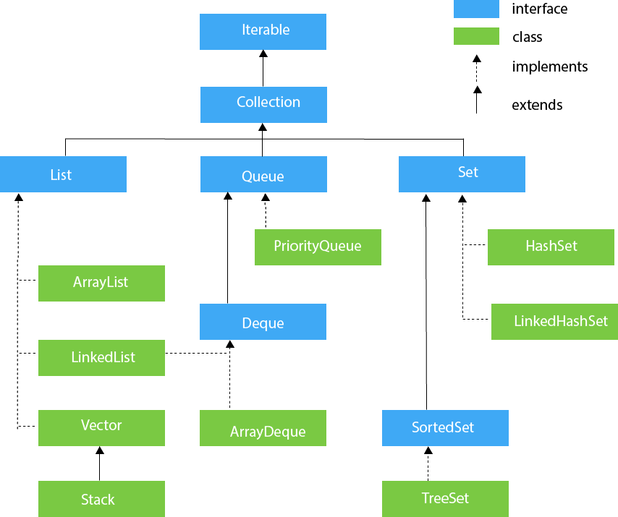

Slide 9
Collection Interface The Collection interface is the interface which is implemented by all the classes in the collection framework. It declares the methods that every collection will have. In other words, we can say that the Collection interface builds the foundation on which the collection framework depends. Some of the methods of Collection interface are Boolean add (Object obj), Boolean addAll (Collection c), void clear(), etc. that are implemented by all the subclasses of Collection interface. List Interface List interface is the child interface of Collection interface. It inhibits a list type data structure in which we can store the ordered collection of objects. It can have duplicate values. List interface is implemented by the classes ArrayList, LinkedList, Vector, and Stack. ArrayList The ArrayList class implements the List interface. It uses a dynamic array to store the duplicate element of different data types. The ArrayList class maintains the insertion order and is non-synchronized. The elements stored in the ArrayList class can be randomly accessed.

Slide 10
LinkedList LinkedList implements the Collection interface. It uses a doubly linked list internally to store the elements. It can store the duplicate elements. It maintains the insertion order and is not synchronized. In LinkedList, the manipulation is fast because no shifting is required. Vector Vector uses a dynamic array to store the data elements. It is similar to ArrayList. However, it is synchronized and contains many methods that are not the part of Collection framework. Stack The stack is the subclass of Vector. It implements the last-in-first-out data structure, i.e., Stack. The stack contains all of the methods of Vector class and also provides its methods like boolean push(), boolean peek(), boolean push(object o), which defines its properties. Queue Interface Queue interface maintains the first-in-first-out order. It can be defined as an ordered list that is used to hold the elements which are about to be processed. There are various classes like PriorityQueue, Deque, and ArrayDeque which implements the Queue interface.

Slide 11
PriorityQueue The PriorityQueue class implements the Queue interface. It holds the elements or objects which are to be processed by their priorities. PriorityQueue doesn't allow null values to be stored in the queue. Deque Interface Deque interface extends the Queue interface. In Deque, we can remove and add the elements from both the side. Deque stands for a double-ended queue which enables us to perform the operations at both the ends. ArrayDeque ArrayDeque class implements the Deque interface. It facilitates us to use the Deque. Unlike queue, we can add or delete the elements from both the ends. ArrayDeque is faster than ArrayList and Stack and has no capacity restrictions. Set Interface Set Interface in Java is present in java.util package. It extends the Collection interface. It represents the unordered set of elements which doesn't allow us to store the duplicate items. We can store at most one null value in Set. Set is implemented by HashSet, LinkedHashSet, and TreeSet.

Slide 12
HashSet HashSet class implements Set Interface. It represents the collection that uses a hash table for storage. Hashing is used to store the elements in the HashSet. It contains unique items. LinkedHashSet LinkedHashSet class represents the LinkedList implementation of Set Interface. It extends the HashSet class and implements Set interface. Like HashSet, It also contains unique elements. It maintains the insertion order and permits null elements. SortedSet Interface SortedSet is the alternate of Set interface that provides a total ordering on its elements. The elements of the SortedSet are arranged in the increasing (ascending) order. The SortedSet provides the additional methods that inhibit the natural ordering of the elements. TreeSet Java TreeSet class implements the Set interface that uses a tree for storage. Like HashSet, TreeSet also contains unique elements. However, the access and retrieval time of TreeSet is quite fast. The elements in TreeSet stored in ascending order.

Slide 13
Map Interface The Map interface in Java is part of the Java Collections Framework. It represents a mapping between a set of keys and their corresponding values. A Map cannot contain duplicate keys; each key can map to at most one value. The Map interface is used to store key-value pairs, where each key is unique, and it provides an efficient way to retrieve, update, and manipulate data based on keys. HashMap HashMap in Java is a key-value data structure offering efficient data access via keys using hashing. Hashing converts large strings or other objects into smaller, consistent values for quick indexing and searching. HashMap implements the Map interface and is used for managing large datasets efficiently. Additionally, HashSet uses HashMap internally to store elements uniquely, demonstrating the utility of hashing in Java's collections framework for fast data retrieval and management.

Slide 14
THANKYOU

